Slide 1
CS419 Recitation Class
Topic：Cryptography
Notes:
/krɪpˈtɑːɡrəfi/

Slide 2
Approaches to Secure Communication
The most fundamental problem cryptography addresses: ensure security of communication over insecure medium
Steganography
“covered writing”
hides the existence of a message
depends on secrecy of method
Cryptography
“hidden writing”
hide the meaning of a message
depends on secrecy of a short key, not method
Notes:
/,stegə'nɔgrəfi/

Slide 3
Basic Terminology
Plaintext original message
Ciphertext transformed message
Key secret used in transformation
Encryption plaintext → ciphertext
Decryption ciphertext → plaintext
Cipher algorithm for encryption/decryption

Slide 4
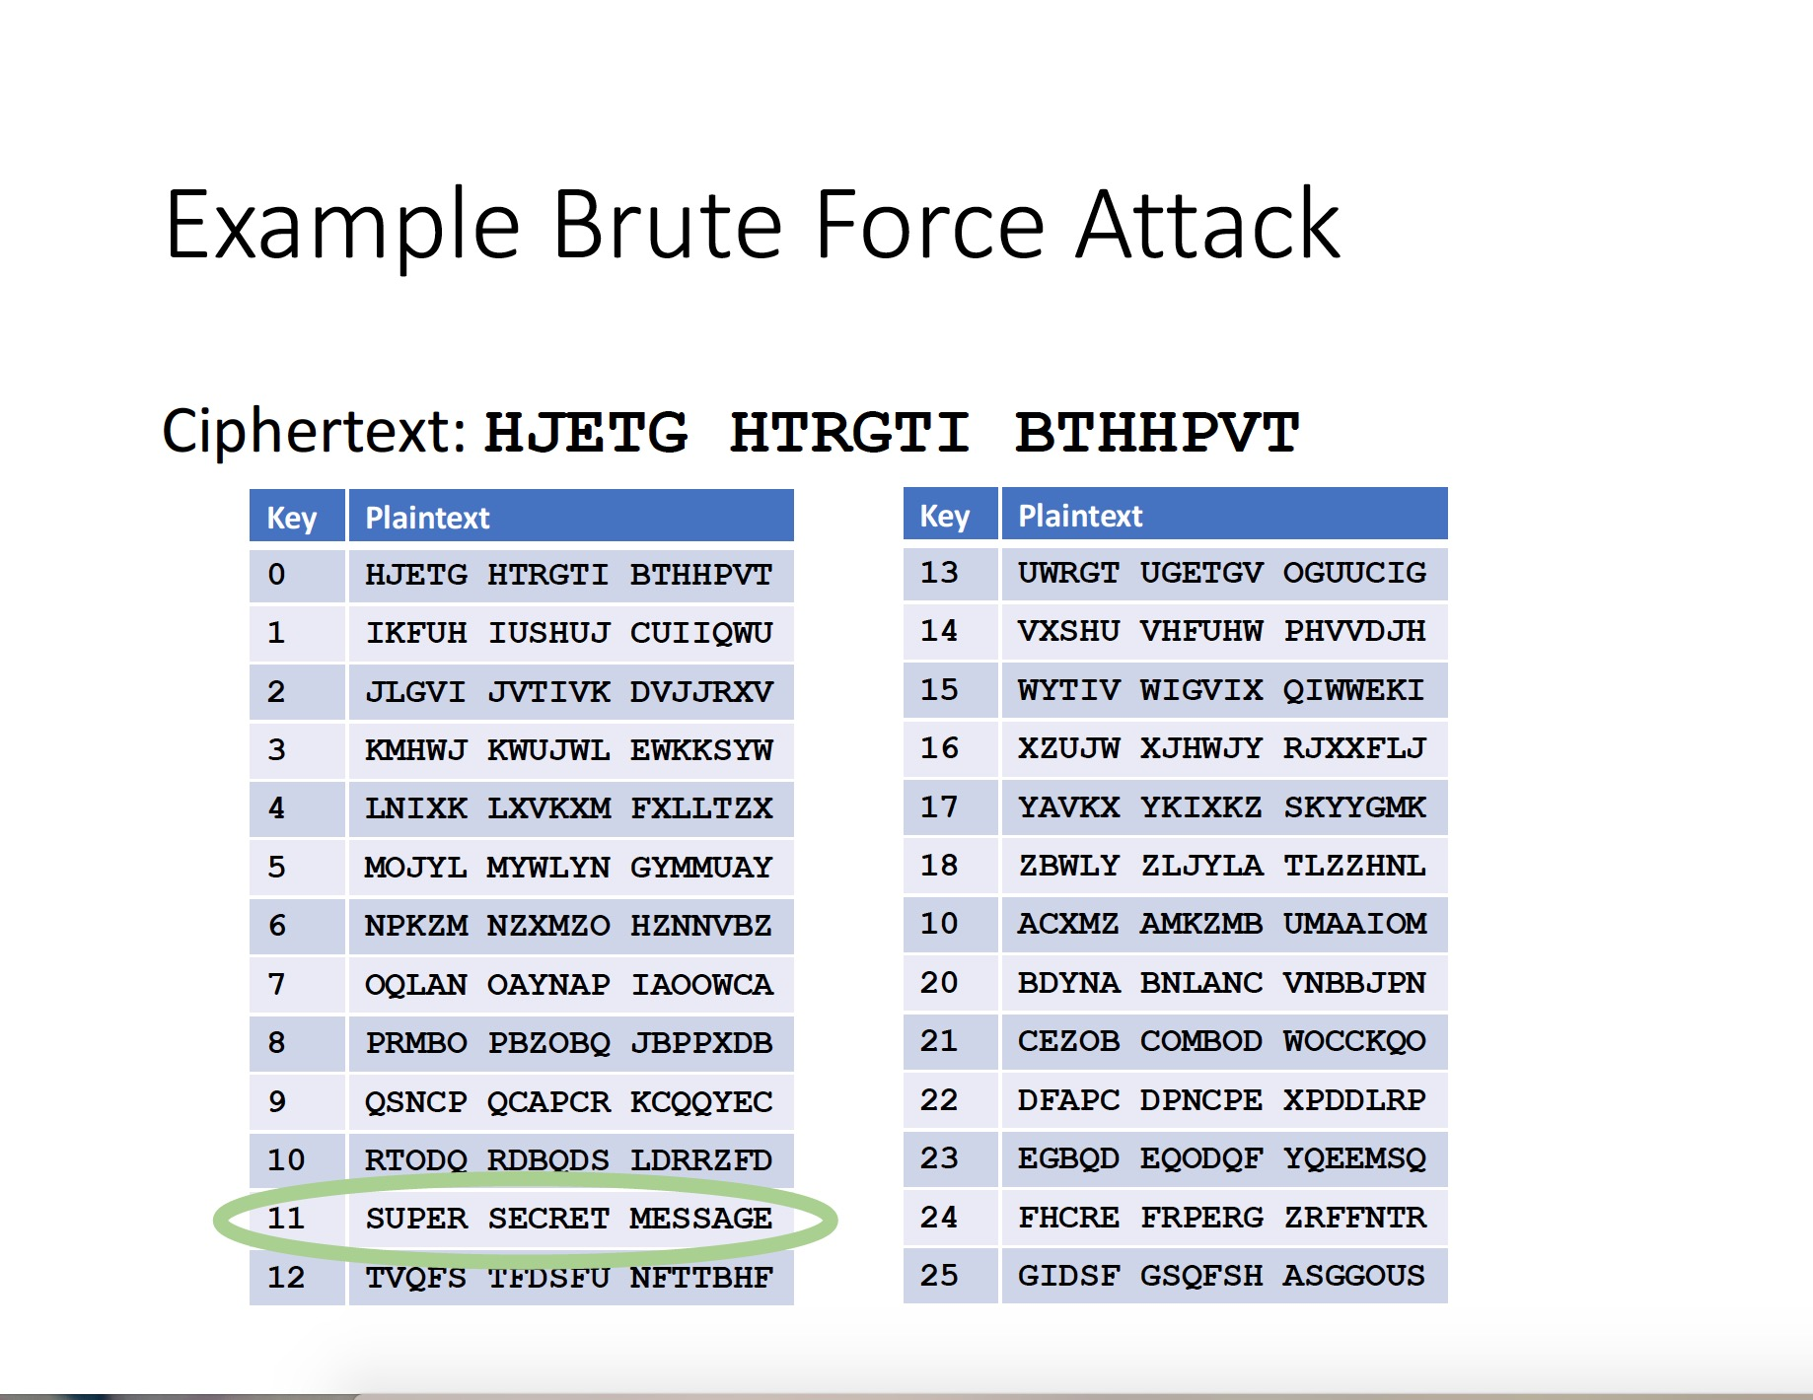
1. Shift Cipher
The Key Space:
[0 .. 25]
Encryption given a key K:
each letter in the plaintext P is replaced with the K’th letter following corresponding number (shift right)
Decryption given K:
shift left
Can an attacker find K?
YES: by a bruteforce attack through exhaustive key search
key space is small (<= 26 possible keys).

Slide 5
2. Mono-alphabetic Substitution Cipher
The key space: all permutations of Σ = {A, B, C, …, Z}
Encryption given a key π:
each letter X in the plaintext P is replaced with π(X)
Decryption given a key π:
each letter Y in the ciphertext P is replaced with π⁻¹(Y)
Example:
A B C D E F G H I J K L M N O P Q R S T U V W X Y Z
π= B A D C Z H W Y G O Q X S V T R N M L K J I P F E U
BECAUSE → AZDBJSZ
Exhaustive search is difficult now:
key space size is 26! ≈ 4×10²⁶ ≈ 2⁸⁸
Frequency Analysis

Slide 6
Frequency Analysis
Basic ideas:
Each language has certain features: frequency of letters, or of groups of two or more letters.
Substitution ciphers preserve the language features.
Substitution ciphers are vulnerable to frequency analysis attacks.

Slide 7
Frequency of Letters in English

Slide 8
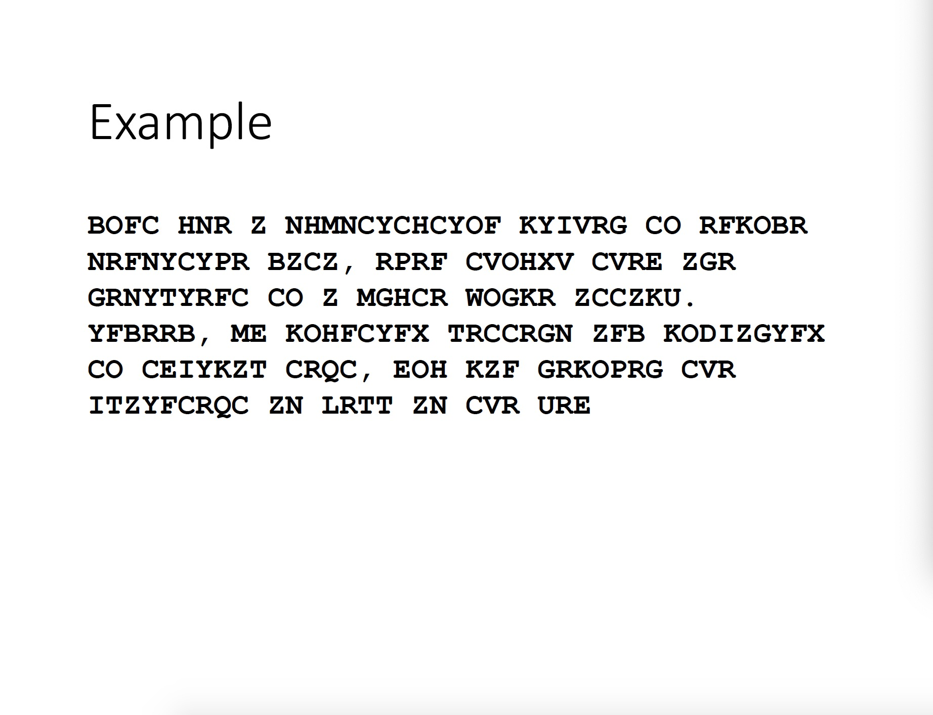
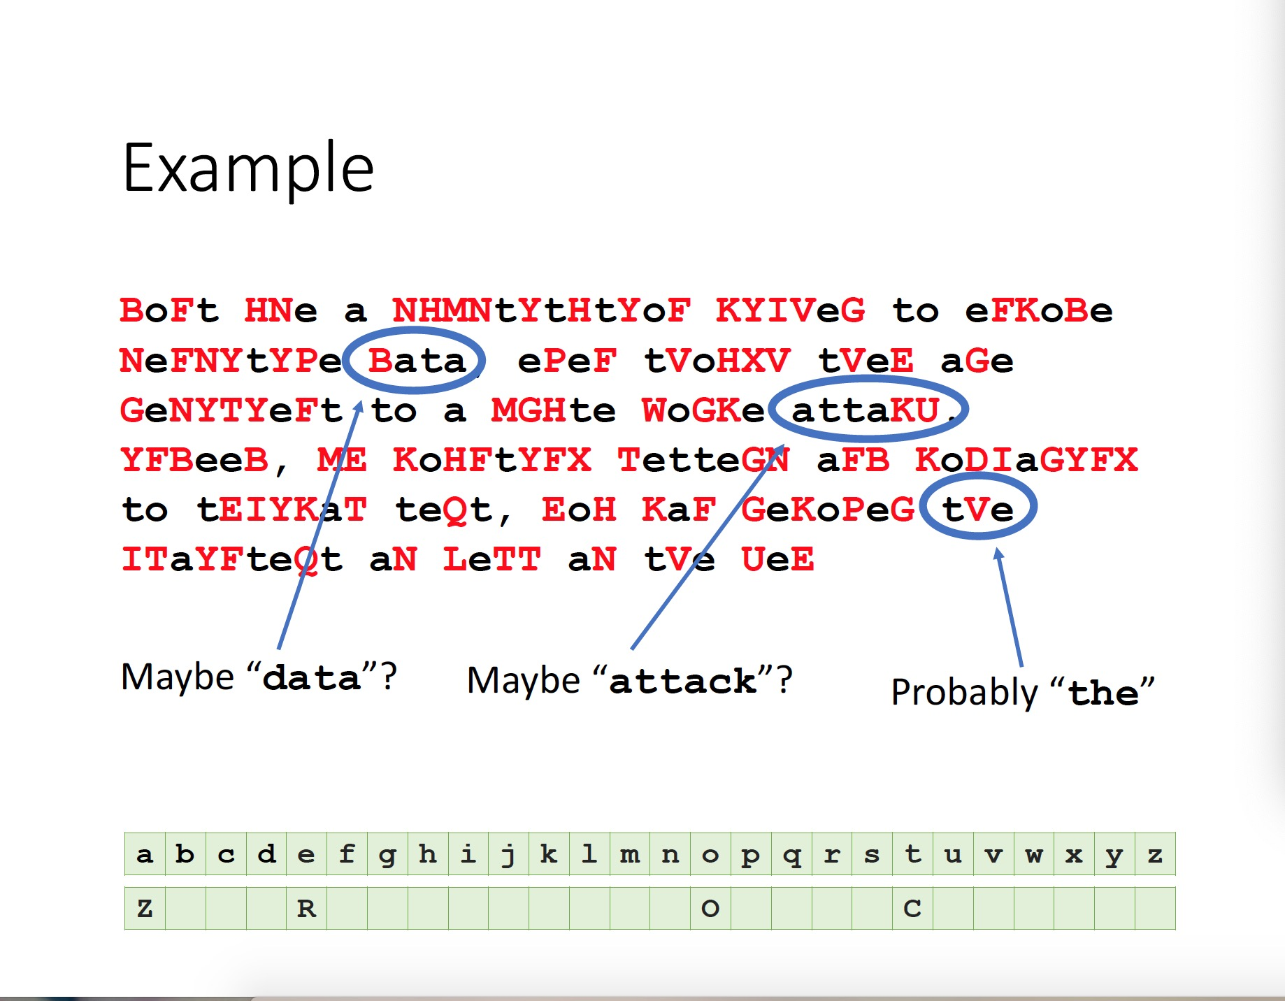
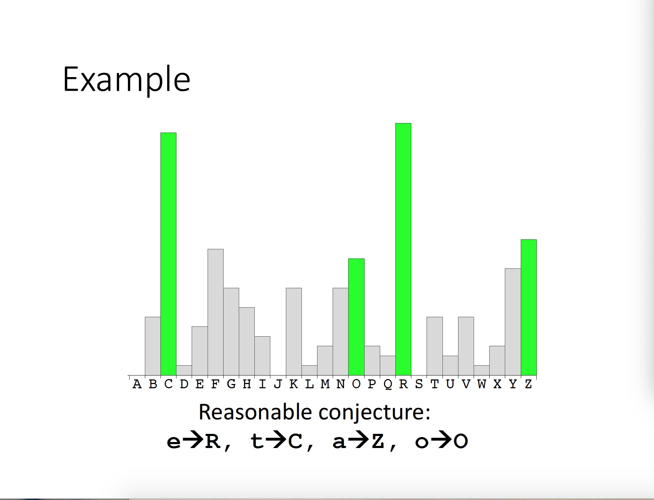

Slide 9
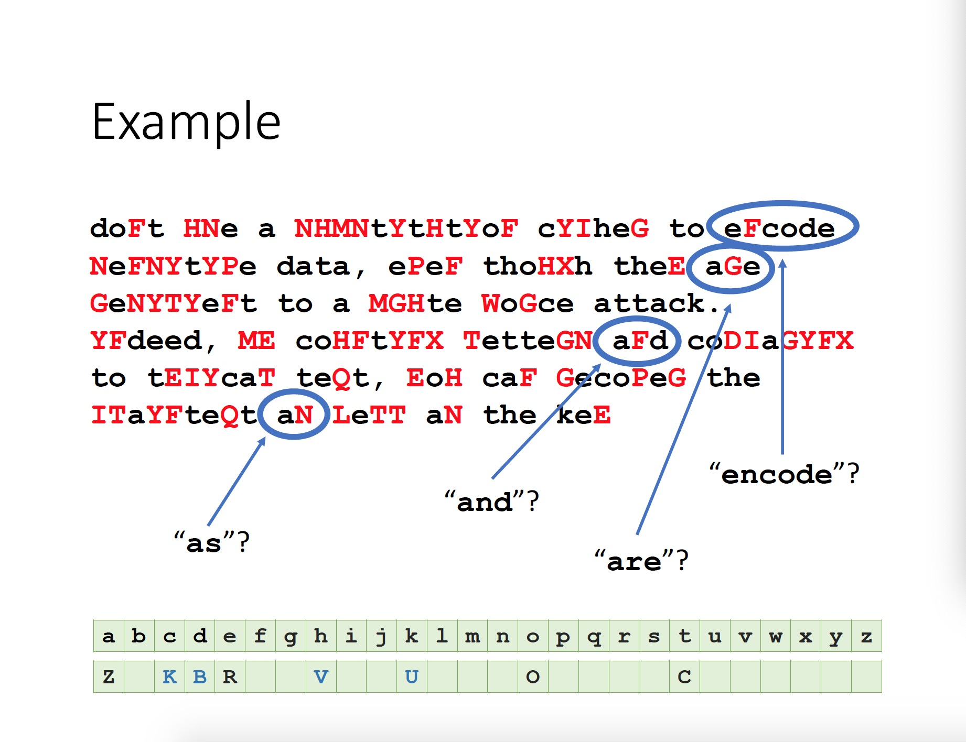
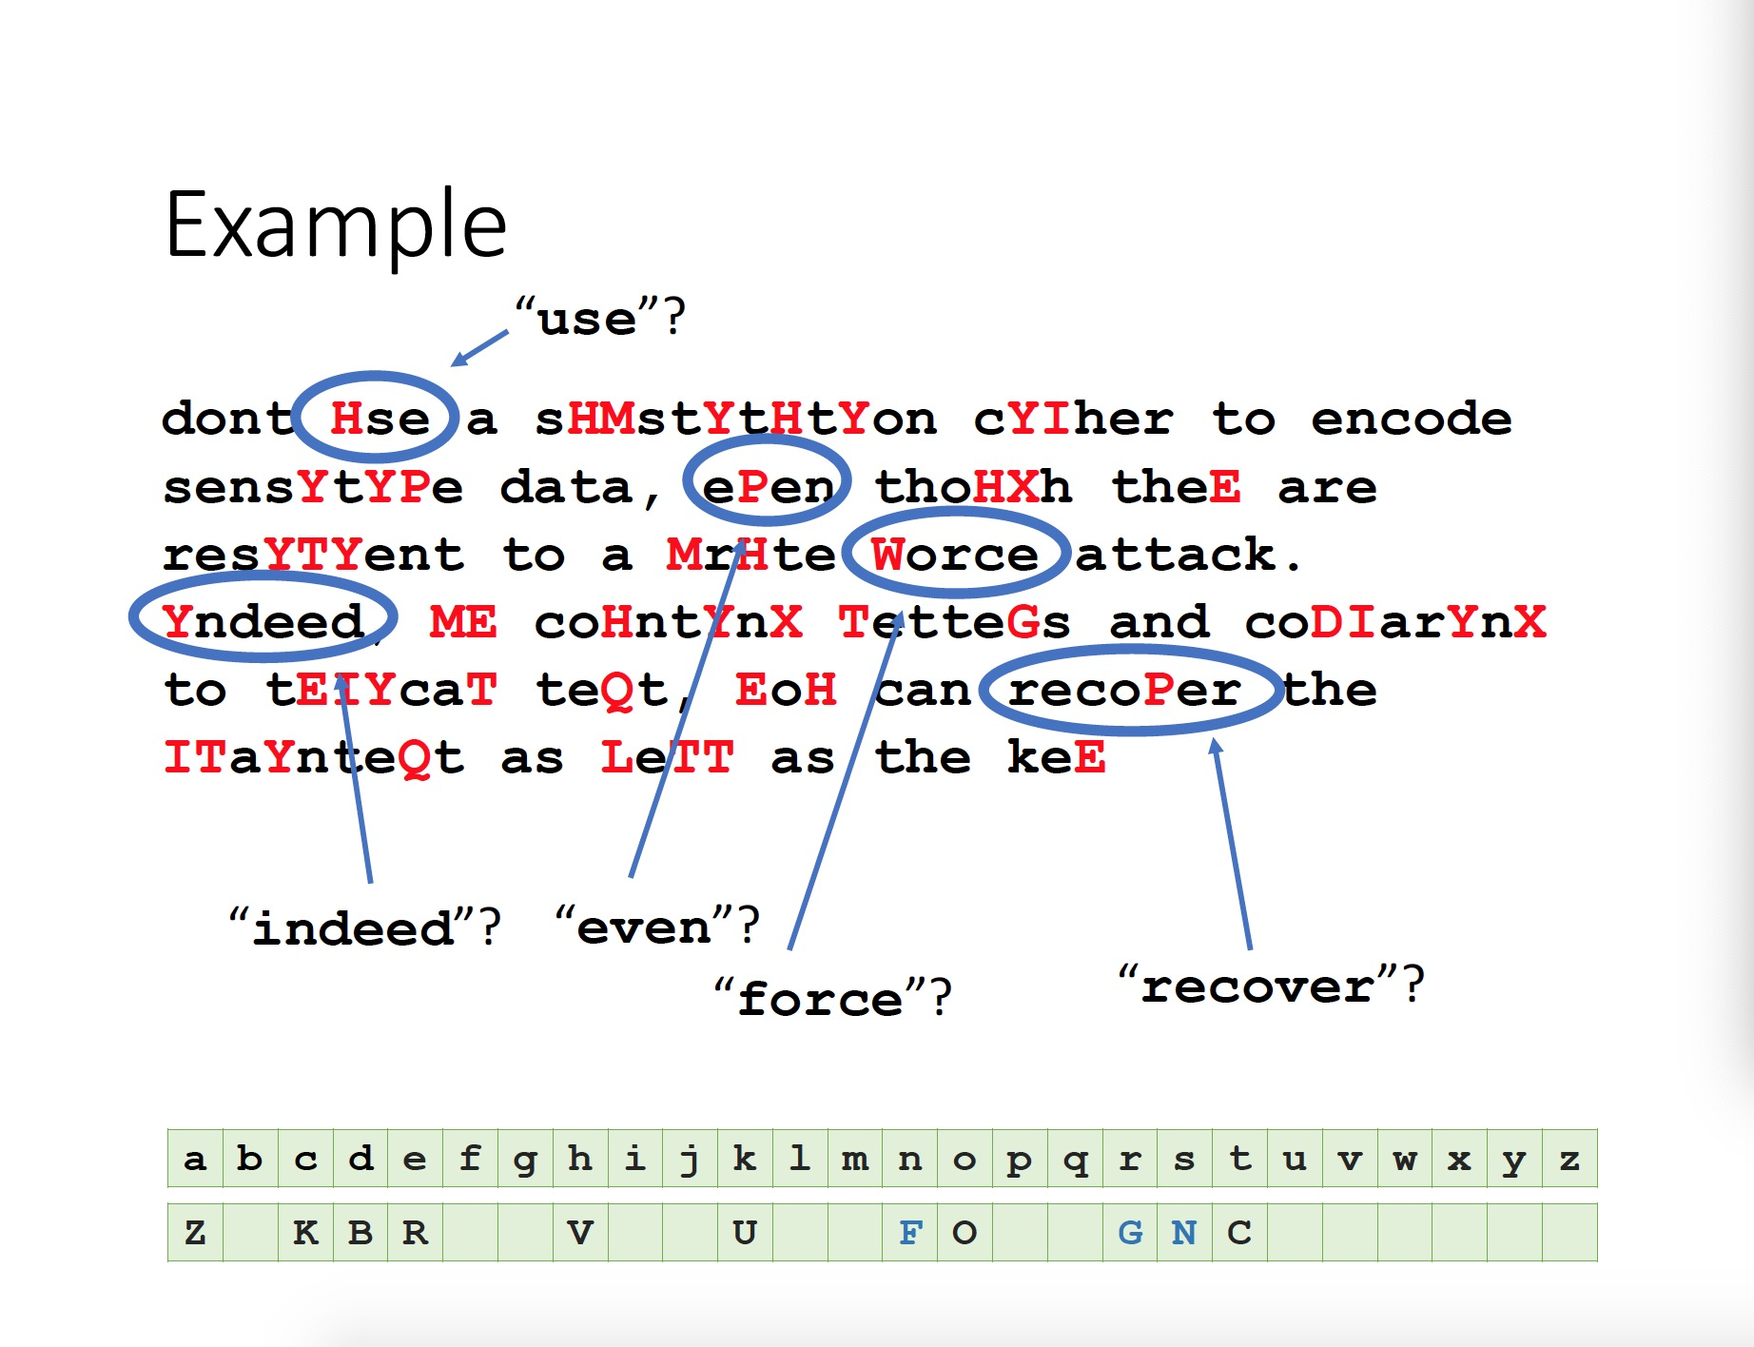
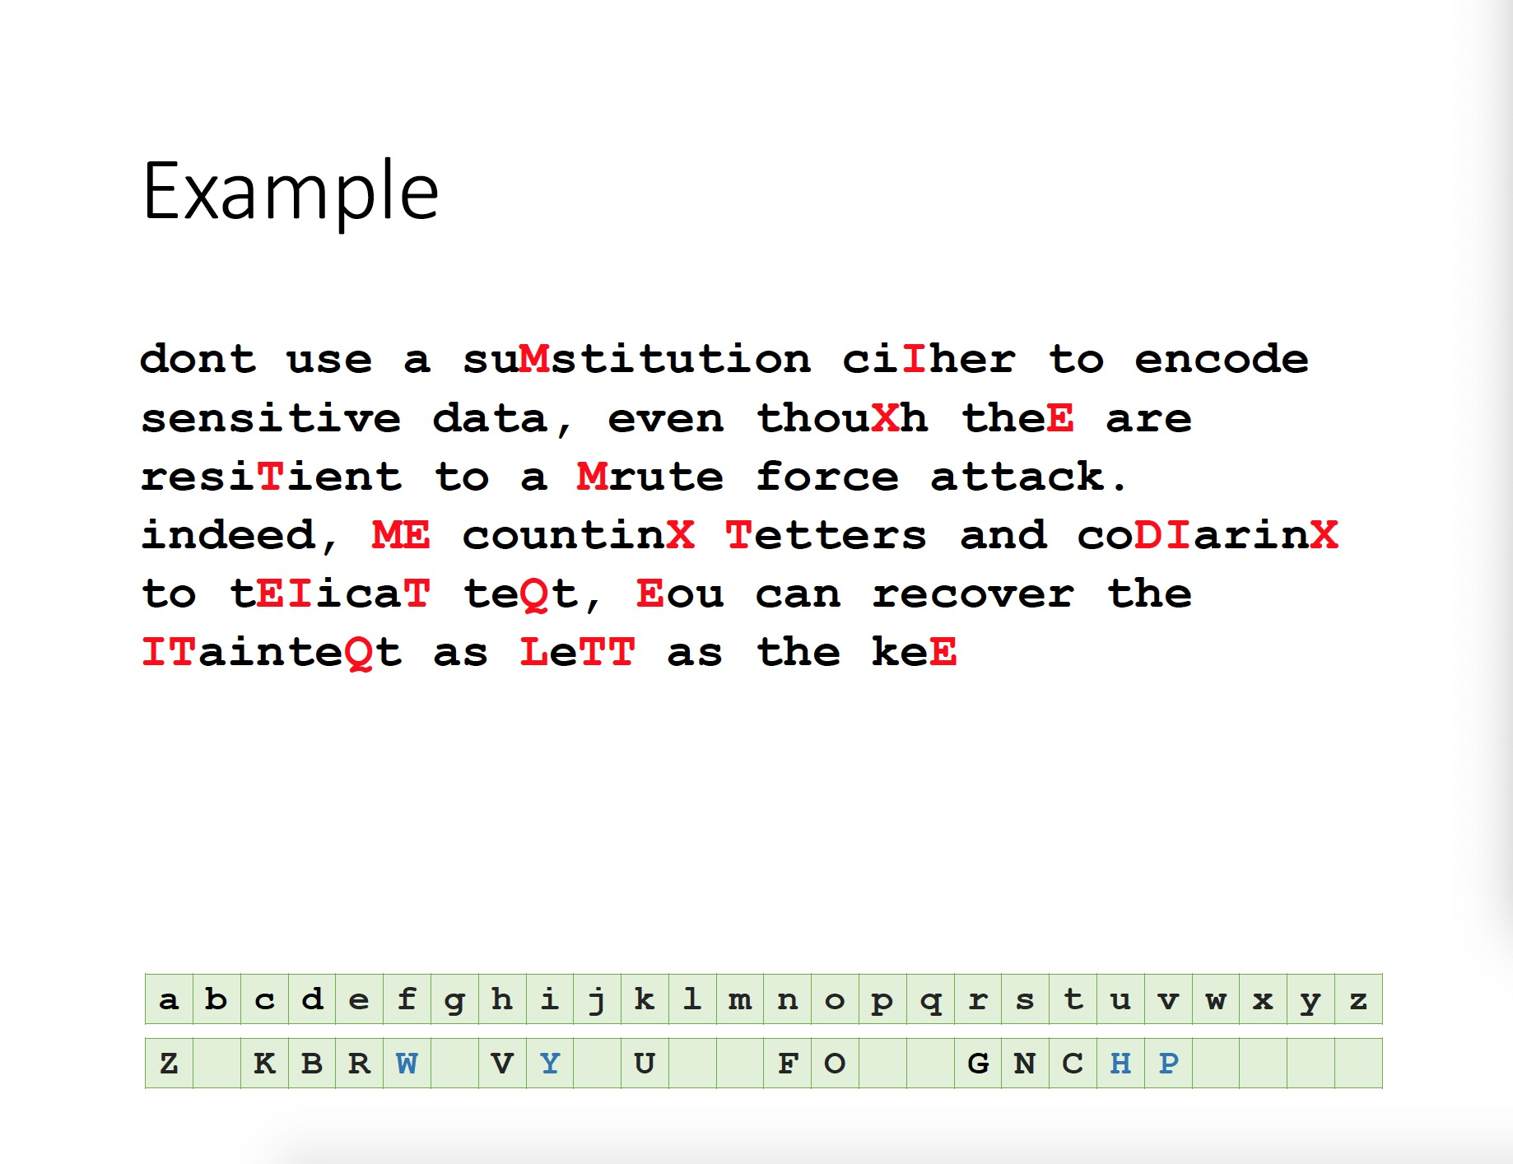
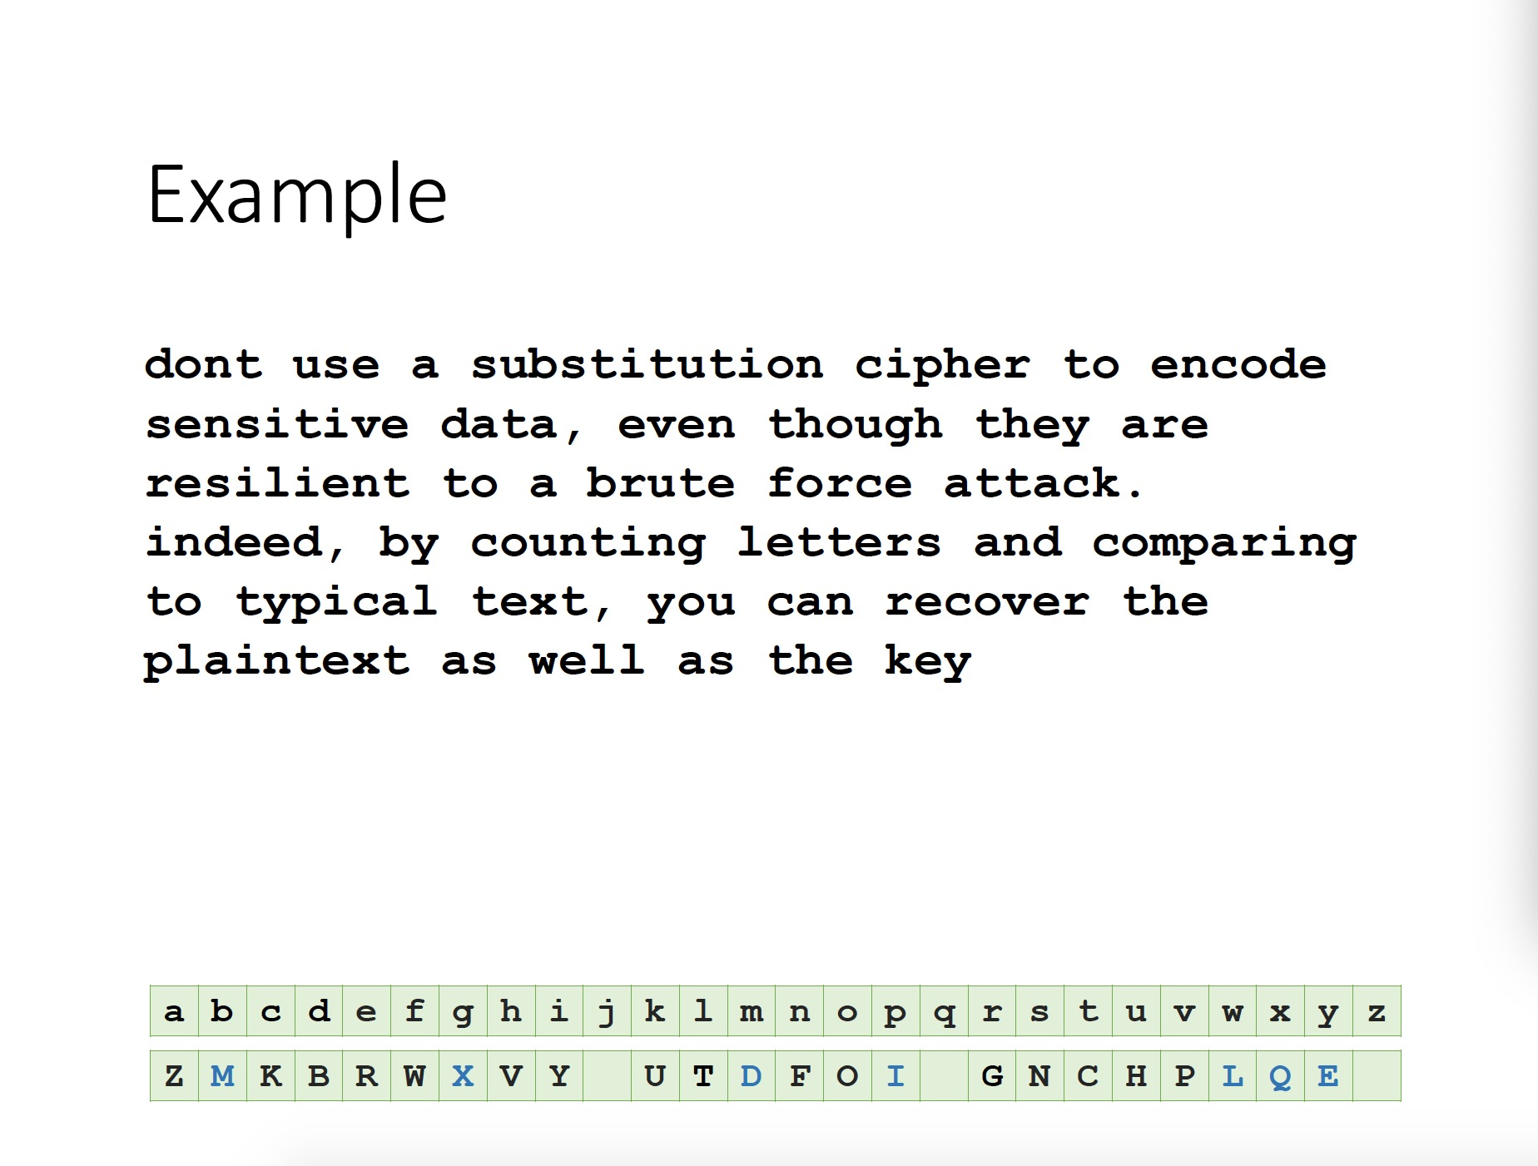

Slide 10
3. Polyalphabetic Substitution Ciphers
How to Defeat Frequency Analysis?
Use different substitutions to get rid of frequency features.
Leads to polyalphabetic substitution ciphers
Stream ciphers

Slide 11
3. The Vigenère Cipher
Treat letters as numbers: [A=0, B=1, C=2, …, Z=25]
Number Theory Notation: Z_{n}= {0, 1, …, n-1}
Definition:
Given m, a positive integer, P = C = (Z₂₆)^{n}, and K = (k₁, k₂, … , k_{m}) a key, we define:
Encryption:
e_{k}(p₁, p₂… p_{n}) = (p₁+k₁, p₂+k₂…p_{m}+k_{m} , p_{m+1}+k₁ , p_{m+2}+k₂ …) (mod 26)
Decryption:
d_{k}(c₁, c₂… c_{n}) = (c₁-k₁, c₂-k₂ … c_{m}- k_{m} , c_{m+1}-k₁ , c_{m+2}-k₂ …) (mod 26)
Example:
Plaintext: C R Y P T O G R A P H Y
Key: L U C K L U C K L U C K
Ciphertext: N L A Z E I I B L J J I
One letter in the ciphertext corresponds to multiple letters in the plaintext. Makes the use of frequency analysis more difficult

Slide 12
3. The Vigenère Cipher
How to attack Vigenère Cipher ?
The Kasiski examination looks for strings of characters that are repeated in the ciphertext.
Find the length of the key.
Kasiski test
Divide the message into that many shift cipher encryptions.
Use frequency analysis to solve the resulting shift ciphers.
The distances between consecutive occurrences of the strings are likely to be multiples of the length of the keyword.
Find the greatest common divisor among distances → key length
https://en.wikipedia.org/wiki/Kasiski_examination
https://planetcalc.com/8550/
Example: abcdefxyzlmnxyzabcdef
Notes:
Vidgenni e

